Slide 1
Soil Fertility and Soil Health issues and Their Management
Dr. Raza Ullah Khan
PSO, LRRI-National Agricultural Research Center

Slide 2
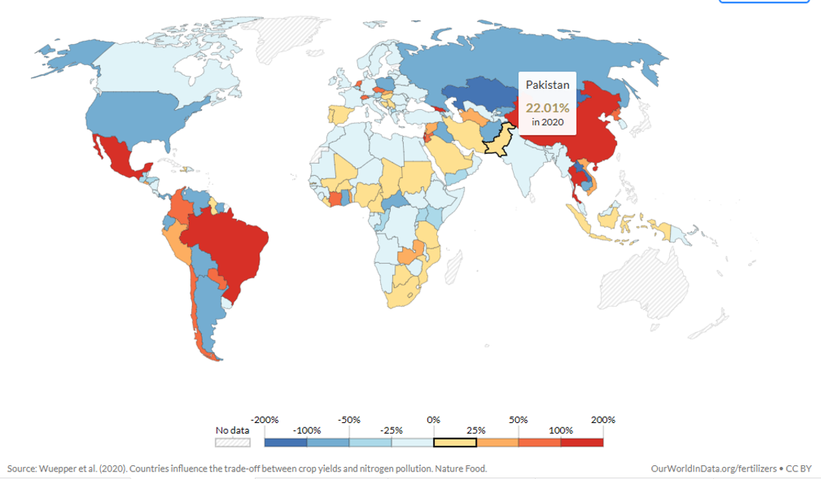
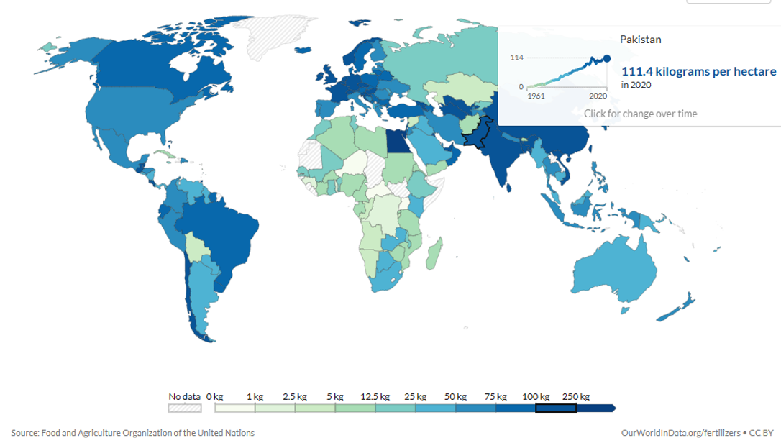
Challenges:
Low nitrogen use efficiency (nitrogen in crop/ nitrogen applied by fertilizers) (Fig. 1).
High Nitrogen use (112 kg/ha) (Fig. 2).
Poor Soil Quality
(High pH, Low Organic Matter (High lime, low fertility)
Fig: 1: Low NUE
Fig. 1: High Nitrogen Use

Slide 3
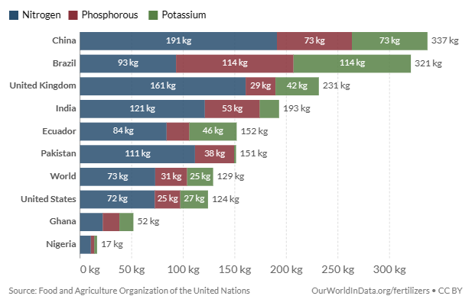
Conti;
Wide N:P: K/imbalance Fertilizer use (Fig. 3).
Fig. 3: Wide N:P: K

Slide 4
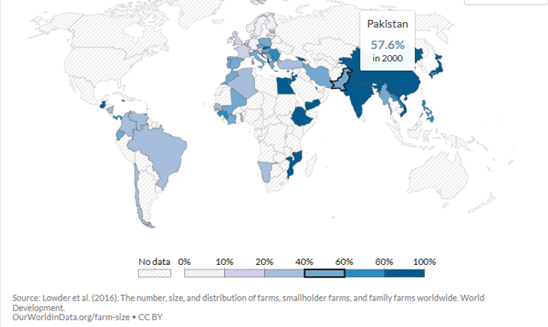
Pakistan’s farm economy is dominated (57.6%) by small holders (owns <12.5 acres land) (Fig. 4).
Fig. 4: Small landholders in Pakistan

Slide 5
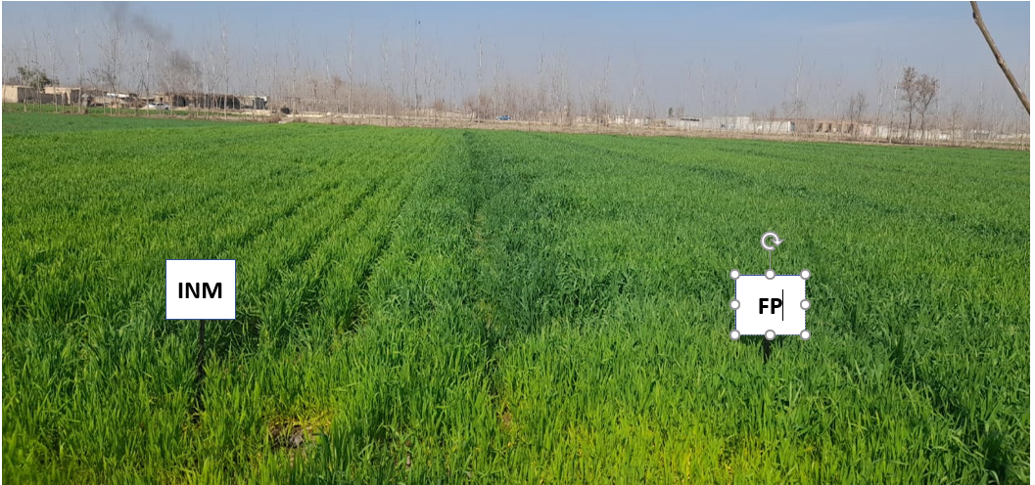
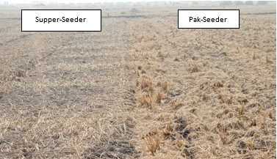
Mitigation & Adaptation Practices/options:
Promote integrated nutrients management (INM) technology;
Increase crop productivity (Fig. 5)
Offset Greenhouse gases (CO₂, N₂O) emission
Coating of nitrogen fertilizer
Deep placement of urea in rice cultivation
Incorporate crop residues to paddy field to achieve;
Soil fertility and carbon storage (Fg. 6)
Counter Smog due to residue burning
Adopt direct seeding rice technology
Cover cropping, intercropping, green manuring to improve soil health.
Fig. 5: INM Vs. Farmer practice (FP)
Fig. 6: Crop residue management

Slide 6
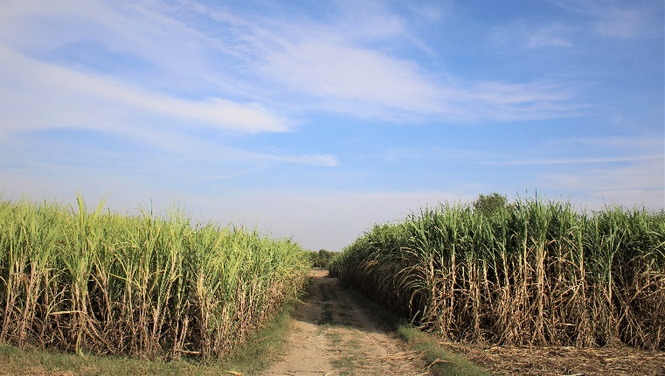
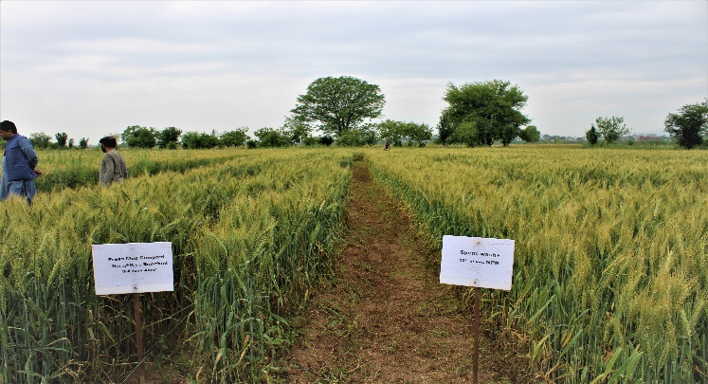
Promote integrated nutrients management (INM) technology;
Sugarcane yield Increase up to 15% (Fig. 7)
Combining organic and in-organic (Industry waste)
Spent wash with Press mud and chemical fertilizers increases wheat yield
Fig. 7: FP Vs. INM
Fig. 6: Combine use of organic and in-organic

Slide 7
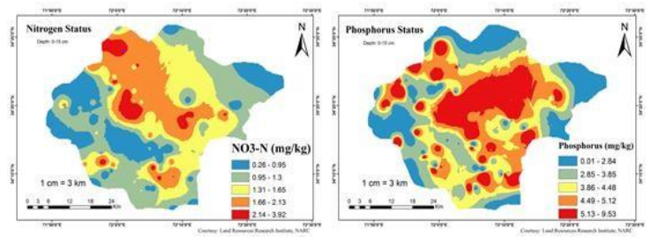
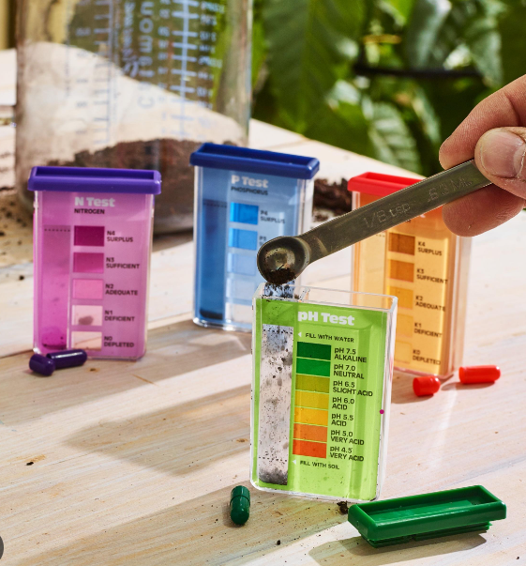
Conti;
Tailoring validated fertility management practices to local conditions
Promote site specific nutrient management
approaches
Nutrient indexing survey-to ascertain soil nutrients
status
Evolve fertilizer application program
Promote soil testing by provision of soil analysis kits
To guide in fertilizer application
Optimized yield, improve soil health
Figure 7: Georeferenced soil nutrients mapping
Figure 8: Soil analysis kits

Slide 8
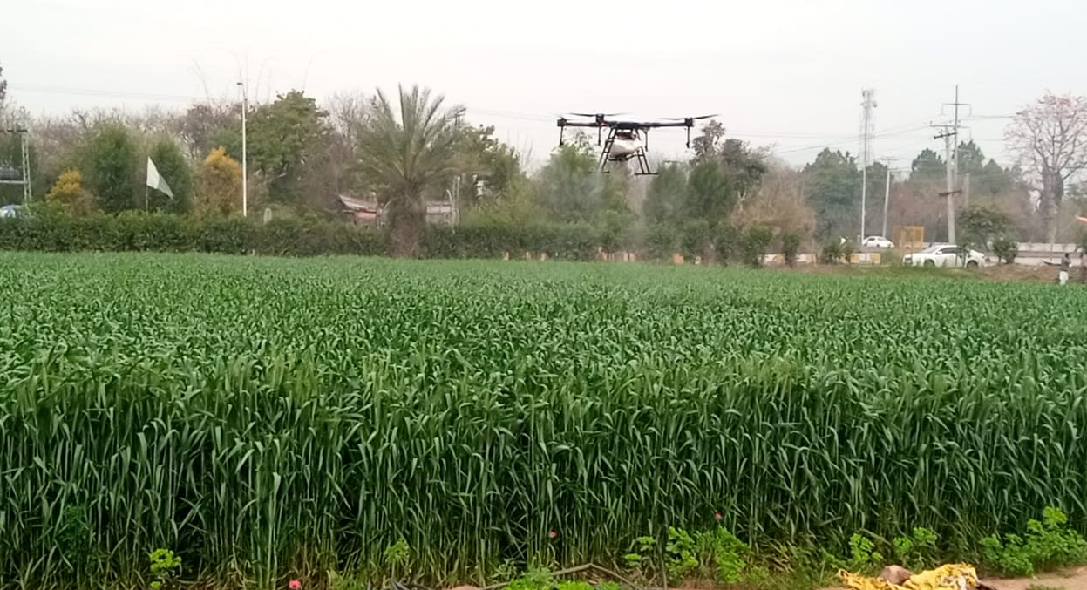
Foliar spray of nutrients using drone technology
(Figure 9).
Fertilizer band placement tech. to enhance Phosphorus use efficiency (Figure 10).
Figure 9: Foliar spray of humic acid by Drone tech.
Figure 10: Band Placement of Phosphate by Drill

Slide 9
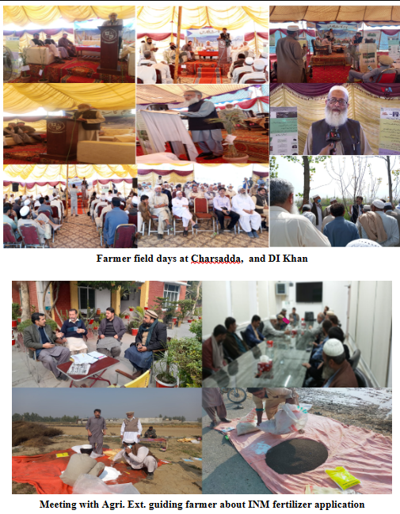
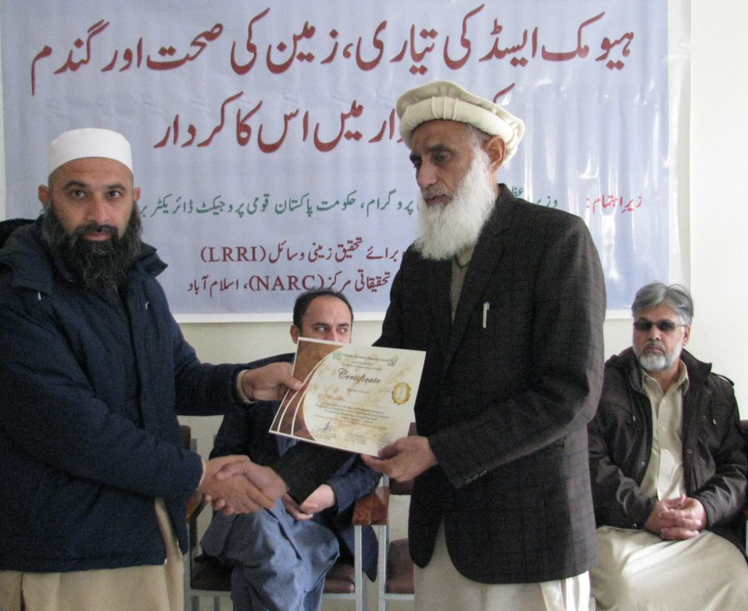
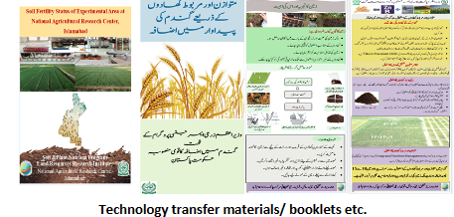
Capacity Building:
Dissemination of best management practices
Organizing farmer field days and trainings
Publication of training manuals and ext. materials

Slide 10
Progress so far on Proposed Project:
13 March, 2023 a meeting was held with USDA officials at PARC, chairman PARC chaired the meeting.
USDA team expressed their desire to work on fertilizer in major crops with PARC and other stalk holders.
Team member Abiola briefed participants about the proposed research activity and expressed his desire to improve fertilizer use efficiency in major crops.
Following the initiative, US ambassador His Excellency Mr. Donald Blome during his visit to NARC show his willingness and desire to work with Pakistan in “Fertilizer Right” project implemented by the USDA Foreign Agricultural Service under the U.S. Department of State’s Global Fertilizer Challenge.
Mr. Abiola Global Prog. Team Leader Develop. Asstt. Express said” We are not doing any things for Pakistan, but we are ready to do everything with Pakistan”. The activity is part of Global Fertilizer Challenge aimed at helping Pakistan through US-Pakistan Green Alliance to work on innovative research, demonstration, and trainings.

Slide 11
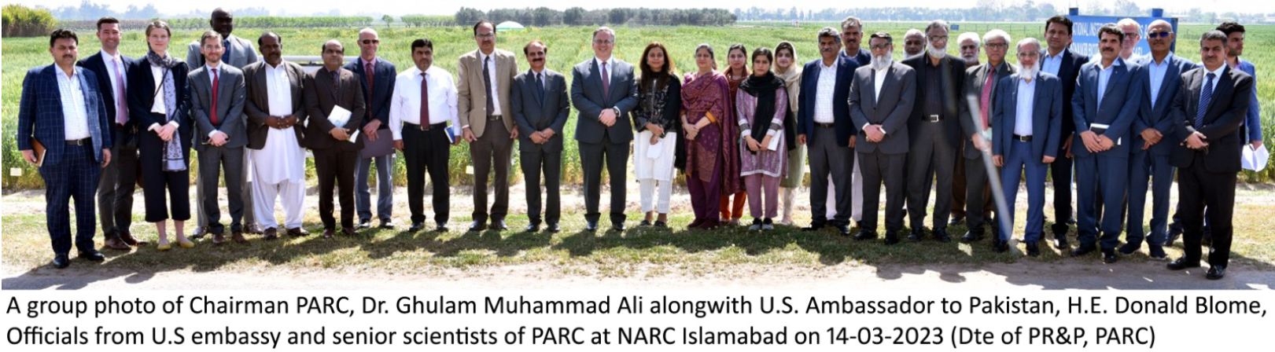
Thank You

